Slide 1
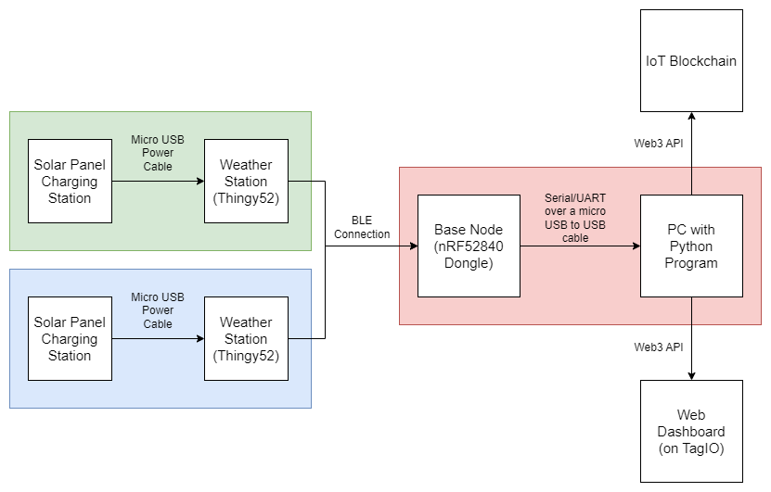
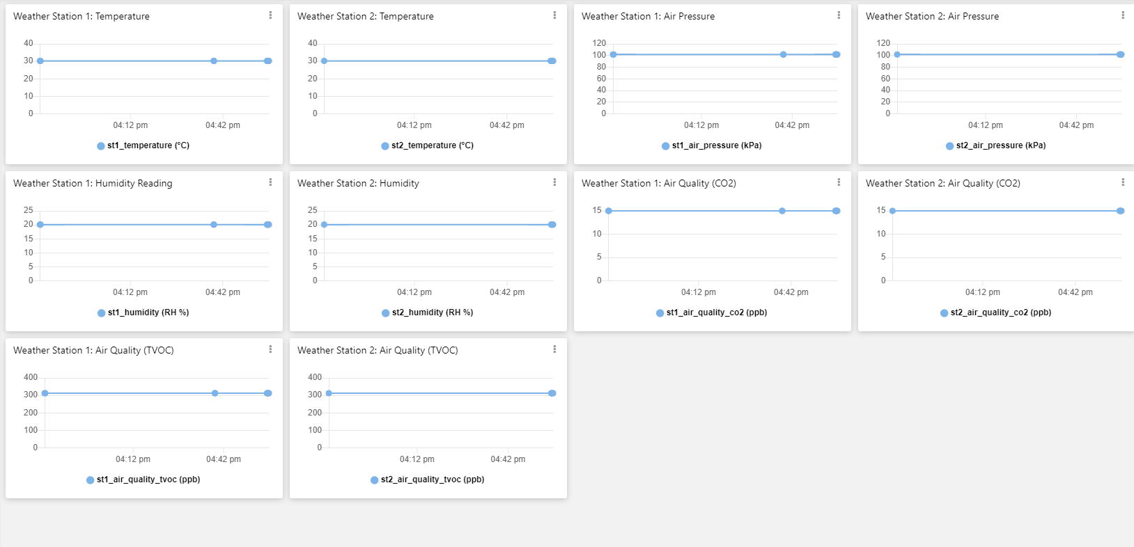
Air quality & Weather station NETWORK
Adrian Silins & Arthur Hoffmann, Gunnar-Green)
System Overview:
Aims (KPIs):
1. Web Dashboard Output:
Temperature, air quality, humidity, and air pressure from the 2 weather stations displayed with little latency.
2. Accurate Sensor Readings:
The two weather stations should provide accurate and logical values.
3. Weather Station Bluetooth Connectivity:
Stations should be able to automatically connect and disconnect with the base node depending on their position and power state.
4. IoT Blockchain Functionality:
Sensor readings collected on the base node should be able to be sent to the IoT blockchain.
5. Functional with 2 or Less Weather Stations:
The whole system should be able to function with any number of weather stations within 0 to 2.
Results/Conclusions:
Weather station readings were correctly updating in a reasonable amount of time on the web dashboard.
The sensor readings were seemingly mostly accurate with one another and made logical sense. However, the humidity, CO2 and TVOC readings were noticed to be very inaccurate at times.
The two weather stations were able to connect and disconnect appropriately.
The IoT blockchain was working as intended with the weather stations values being uploaded to it.
The entire project functioned as intended for any number of weather stations within 0 to 2.
Web Dashboard Example:
Field Deploying Plan:
1. Connect weather stations to the solar panel charging stations
2. Connect base node into the PC USB port
3. Run python program on the PC with the relevant COM port selected (ensure Pyserial and Tago are pip installed as well)
4. Open the web dashboard and ensure weather stations are connected over Bluetooth to the base node and powered on

